Slide 1


Objectives
In this session, you will learn to:
  Define common terms used in computer networking.
  Identify the primary building blocks used to construct networks.
  List the standard networking models.
  List the primary network topologies.
  List the primary categories of networks.

Slide 2
Networking Terminology
Some of the common terminologies that are used in computer networking are:
  Networks
  Server
  Client
  Peers
  Host computers
  Terminals
  Authentication
  Encryption
  Network Directories
  Networking Standards
  Standards organizations

Slide 3
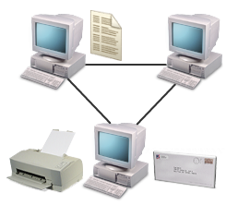
Networks
A computer network is a group of computers that are connected together to communicate and share resources such as files, printers, and email.

Slide 4
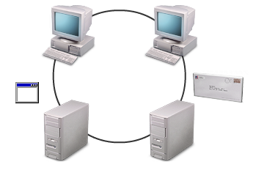
Servers
A server is a network computer that shares resources with and responds to requests form other network computers, including other servers.
General Purpose
Dedicated
Server
Server

Slide 5
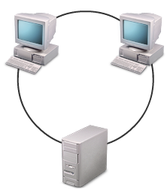
Clients
A client is a network computer that utilizes the resources of other network computers including other clients.
Processor, memory, storage
Client 1
Client 2
Server

Slide 6
Peers
A peer is a self-sufficient computer that acts as both a server and a client to other similar computers on the network.
Peer
Peer
Client and server
Client and server
Client and server
Peer

Slide 7
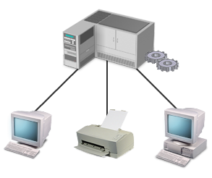
Host Computers
A host computer is a powerful, centralized computer system, such as a mainframe computer, that performs data storage and processing tasks on behalf of clients and other network devices.
Processing and storage
Processing and Storage
Network devices
Notes:
You need to also tell about TC/IP hosts given in the page no 5 of CG

Slide 8
Terminals
A terminal is a specialized network device on a host-based network that transmits the data entered by the user to host for processing and displays the results.
No processor
and no memory
Terminal
Client
Notes:
You need to also tell about Terminal Emulator program given in the page no 6 of CG.

Slide 9

Authentication
Authentication is a network security measure in which a computer user or some other network component proves its identity in order to gain access to network resources.
The possible authentication method is:
  User Name and Password Authentication
Who I am
How do I know?
User name & password
Approved
Notes:
You need to tell about User Name and Password Authentication given in the page no 7 of the CG

Slide 10




Encryption
Encryption is a network security measure in which information is encoded or scrambled prior to transmission so that it cannot be read unless the recipient knows the decoding mechanism, or key.
Client
Server
Ox12j
Data
Encrypted data
Decrypted data

Slide 11
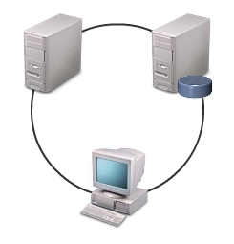
Network Directories
A network directory, or directory service, is a centralized database that includes objects such as servers, clients, computers, usernames, and passwords.
Authentication
Centralized
administration

Slide 12
Networking Standards
A networking standard is a set of specifications, guidelines, or characteristics applied to network components to ensure interoperability and consistency between them.
Formalization of standards is done by International Organization for Standardization.

Slide 13
Standards Organizations
Some of the standards bodies that issue standards are:
  International Organization for Standardization (ISO)
  Institute of Electrical and Electronics Engineers (IEEE)
  American National Standards Institute (ANSI)
  Telecommunications Industry Association (TIA)
  Electronic Industries Alliance (EIA)
  Internet Engineering Task Force (IETF)

Slide 14
Network Building Blocks
The building blocks that are used to construct network are:
  Nodes
  The Network backbone
  Segments
  Subnets

Slide 15
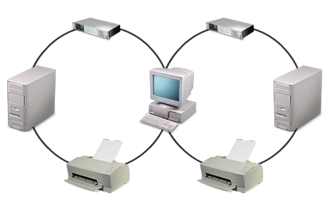
Nodes
A node is any network device that can connect to the network and can generate, process, or transfer network data.
Network nodes can be either:
  Endpoints: Nodes that function as the source or the destination of data
  Redistribution points: Nodes that are devices used to transfer data, such as a network hub or router

Slide 16
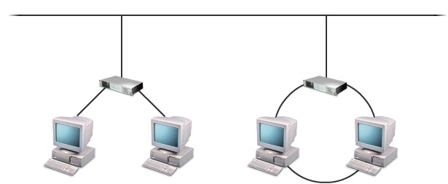
The Network Backbone
The network backbone is the highest-speed transmission path that carries the majority of the network data.
Backbone

Slide 17
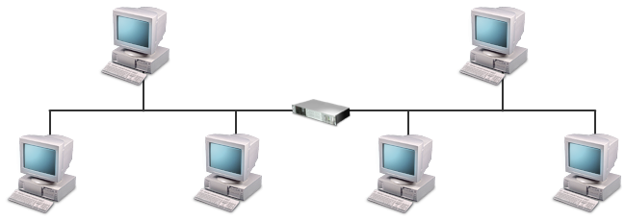
Segments
A segment is any discrete physical subdivision of a network.
A segment is bounded by physical internetworking devices such as hubs, switches, and routers.
Dividing a network into segments can make network performance more efficient.
Segment
Notes:
You need to give explanation how segmentation improves network performance as given in the page no 16 of CG

Slide 18
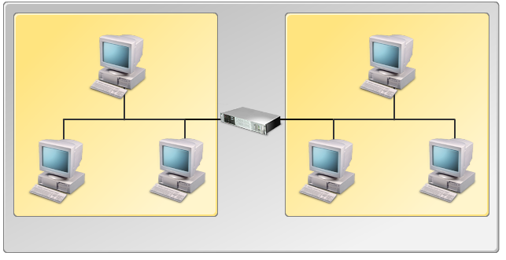
Subnets
A subnet is a portion of a network that shares a common network address.
Subnet 1
Subnet 2
Network

Slide 19
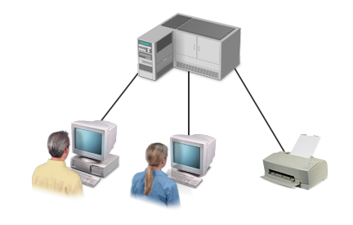
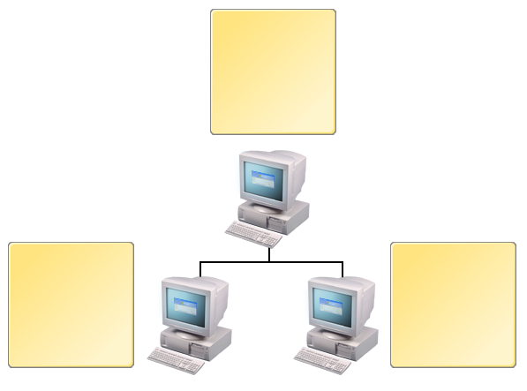

Standard Network Models
A network model is a design specification for how the nodes on a network interact and communicate.
The standard networking models currently in use are:
  Centralized Computing Networks
  Client/Server Networks
  Peer-to-Peer Networks
Centralized
model
Client/server
model
Peer-to-peer
model

Slide 20
Centralized Computing Networks
A centralized network is a network in which a central host controls all network communication and performs data processing and storage on behalf of clients.
Host
Communication
Processing
Storage
User
User
Notes:
You need to tell that the terms “ hierarchical network” and “host-based network” can also be used to describe centralized networks. You need to also tell about Host Computers as given in page no 119 of CG

Slide 21
Client/Server Networks
A client/server network is a network in which servers provides services to clients.
Client 1
Client 2
Processing power
Management services
Server
Administrative functions

Slide 22
Peer-to-Peer Networks
A peer-to-peer network is a network in which resource sharing, processing, and communications control are completely decentralized.
A peer-to-peer network is often referred to as a workgroup.
Resources
Processing
Communication
Resources
Resources
Processing
Processing
Communication
Communication

Slide 23
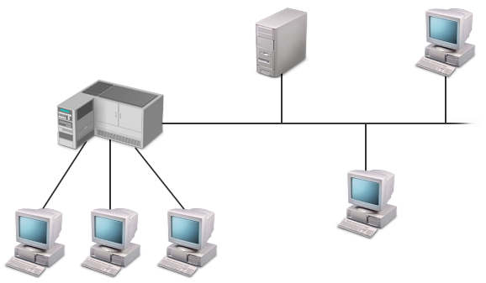
Mixed Mode Networks
A mixed mode network is a network that incorporates elements from more than one of the three standard network models.
Server
Peer/Client
Host
Peer/Client
Notes:
You need to tell about the mixed mode networks uses as given in page no 21 of the CG

Slide 24
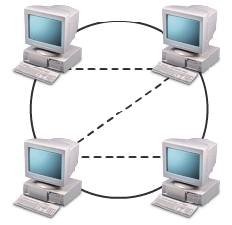
Network Topologies
A network topology is a network specification that determines the network’s overall layout and the network’s data flow patterns.
The primary network topologies are:
  Physical Bus Topology
  Physical Star Topology
  Physical Ring Topology
  Physical Mesh Topology
  Hybrid Topology
  Logical Bus Topology
  Logical Ring Topology
  Logical Star Topology
Physical
Logical

Slide 25
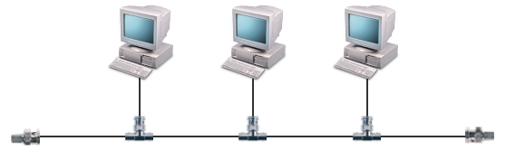
Physical Bus Topology
A physical bus topology is a physical topology in which network nodes are arranged in a linear format, with each node connected directly to the network cable with a T-connector or tap.
Terminator
T-connector
T-connector
T-connector
Terminator

Slide 26
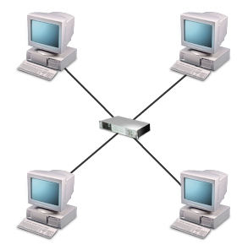
Physical Star Topology
A physical star topology is a network topology that uses a central connectivity device, such as a hub, with separate connections to each node.
Hub
Node

Slide 27
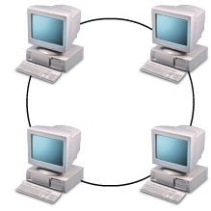
Physical Ring Topology
A physical ring topology is a network topology in which all network nodes are connected in a continuous circle.

Slide 28
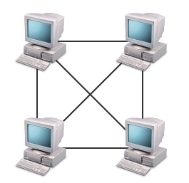
Physical Mesh Topology
A physical mesh topology is a network topology in which each node has a direct connection to every other node.

Slide 29
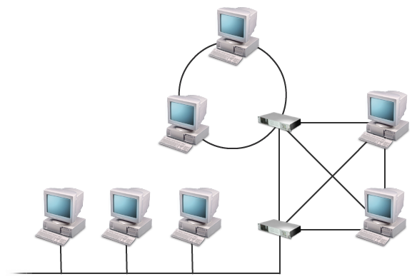
Hybrid Topology
A hybrid topology is any topology that exhibits characteristics of more than one standard physical topology.

Slide 30
Logical Bus Topology
A logical bus topology is a network topology in which all nodes see the network signal at the same time, regardless of the physical wiring layout of the network.
Receiver
Receiver
Sender
Receiver

Slide 31
Logical Ring Topology
A logical ring topology is a network topology in which each node receives data only from its upstream neighbor and retransmits it only to its downstream neighbor, regardless of the physical layout of the network.

Slide 32
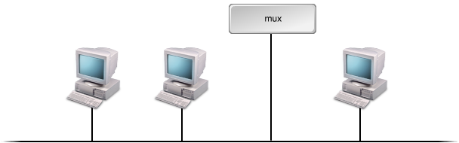
Logical Star Topology
A logical star topology is a network topology in which all the nodes might be wired onto the same bus cable, but a central device polls each node to see if it needs to transmit data.
Polls nodes and controls access

Slide 33
Network Categories
The primary categories that describe a network’s size and extent are:
  Local Area Networks (LAN)
  Wide Area Networks (WAN)
  Metropolitan, Campus, and Other Network Coverage Areas
  The Internet
  Intranets
  Extranets
  Enterprise Networks

Slide 34
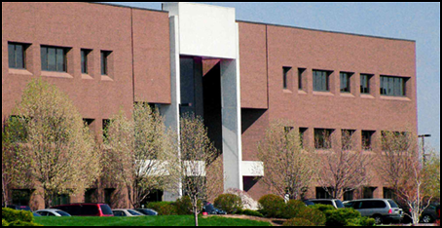
Local Area Networks (LAN)
A local area network is a self-contained network that spans a small area, such as a single building, floor, or room.
LAN 2 room
LAN 1 floor
Notes:
Talk about LAN administrative duties

Slide 35
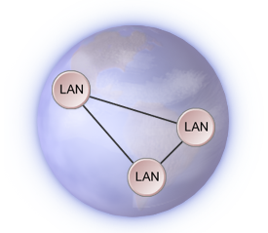
Wide Area Networks (WAN)
A wide area network is a network that spans multiple geographic locations.
Notes:
Talk about WAN administrative duties

Slide 36
Metropolitan, Campus, and Other Network Coverage Areas
A metropolitan area network (MAN), which covers an area equivalent to a city or other municipality.
A campus area network (CAN), which covers an area equivalent to an academic campus or business park.
A global area network (GAN), which is any worldwide network.
Notes:
Talk about WAN administrative duties

Slide 37
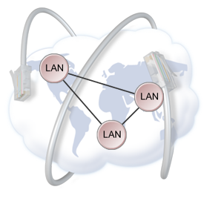
The Internet
The Internet is the single largest global WAN, linking virtually every country, continent, and organization in the world.
Internet standards and practices are overseen by an international consortium that is coordinated by the Internet Society (ISOC).
Notes:
Talk about WAN administrative duties

Slide 38
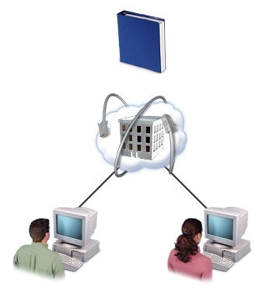
Intranets
An intranet is a private network that employs Internet-style technologies.
Employee handbook
Notes:
Talk about WAN administrative duties

Slide 39
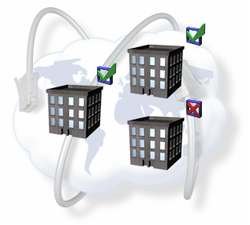
Extranets
An extranet is a private network that employs Internet-style technologies to enable communications between two or more separate companies or organizations.
Company A
Company C
Company B
Notes:
Talk about WAN administrative duties

Slide 40
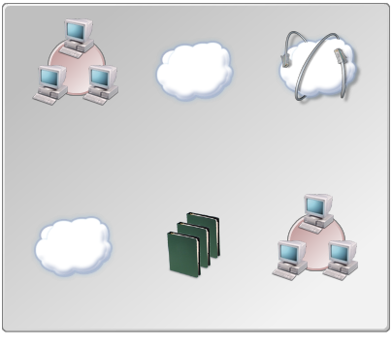
Enterprise Networks
An enterprise network is a network that encompasses all the separate network components employed by a particular organization.
Organization
LAN
WAN
Internet
WAN
Network technologies
LAN
Notes:
Talk about WAN administrative duties

Slide 41
Summary
In this session, you learned that:
  The common terminologies that are used in computer networking are:
    Networks
    Servers
    Clients
    Peers
    Host computers
    Terminals
    Authentication
    Encryption
    Network Directories
    Networking Standards
    Standards Organizations
Notes:
Talk about WAN administrative duties

Slide 42
Summary (Contd.)
Some of the Standard Organizations are:
  International Organization for Standardization (ISO)
  Institute of Electrical and Electronics Engineers (IEEE)
  American National Standards Institute (ANSI)
  Telecommunications Industry Association (TIA)
  Electronic Industries Alliance (EIA)
  Internet Engineering Task Force (IETF)
The building blocks that are used to construct network are:
  Nodes
  The Network backbone
  Segments
  Subnets
Notes:
Talk about WAN administrative duties

Slide 43
Summary (Contd.)
The standard networking models currently in use are:
  Centralized Computing Networks
  Client/Server Networks
  Peer- to-Peer Networks
  Mixed Mode Networks
The primary network topologies are:
  Physical Bus Topology
  Physical Star Topology
  Physical Ring Topology
  Physical Mesh Topology
  Hybrid Topology
  Logical Bus Topology
  Logical Ring Topology
  Logical Star Topology
Notes:
Talk about WAN administrative duties

Slide 44
Summary (Contd.)
The primary categories that describe a network’s size and extent are:
  Local Area Networks (LAN)
  Wide Area Networks (WAN)
  Metropolitan, Campus, and Other Network Coverage Areas
  The Internet
  Intranets
  Extranets
  Enterprise Networks
Notes:
Talk about WAN administrative duties

